Slide 1
Types of Online Advertising/Marketing

Slide 2
Types of Ads
Display Ads
Banner Ads (floating & static)
Pop-up ads
Videos
Text Ads – Search Engines

Slide 3
Banner Ads

Slide 4
Pop-Ups Ads

Slide 5
Videos - How to or story

Slide 6
Text Ads

Slide 7
4 Types of Ad Models (Cost/Payment)
Cost Per Action (CPA)- Pay only for completed action with click
Form completion, call (length), approved application, etc..
Cost Per Click or Pay Per Click (CPC or PPC) – Pay per click on ad.
Bids to appear at the top of the search engine results page (SERP).
Quality Score
Best value package because you’re only charged when people click on the ad.
Easiest to track during the campaign.
Cost Per Mille or Thousand (CPM or CPT) - billed a flat rate for 1,000 impressions - pay for based on views to an ad.
Example: If a website gets two million visitors per day, and the ad is seen on 50% of those pages, then a CPM of $2 would be equal to $2000.
Easy to apply a budget and you’re guaranteed a number of “shows” on the SERP.
Risk overspending - if no one clicks through you’re paying for views/branding.
Flat fee
Set fee, easy for budgeting
Make sure it’s worth the fee

Slide 8
7 Types of Advertising
Search Engine Marketing (SEM) or Keyword Marketing
Social Media Advertising
Display Advertising
Remarketing/Retargeting
Video Advertising
Email Marketing
Blog/Content Sponsorship (Native Advertising) – write blog for another site for link & authority &/or sponsor content with your ad at the bottom

Slide 9
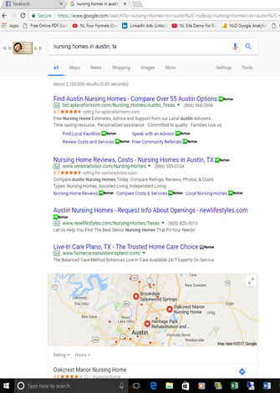
Search Engine Marketing (SEM) or Keyword Marketing
On Google, Bing, etc..
Keyword, location, device, language, time & site(s) - AdSense

Slide 10
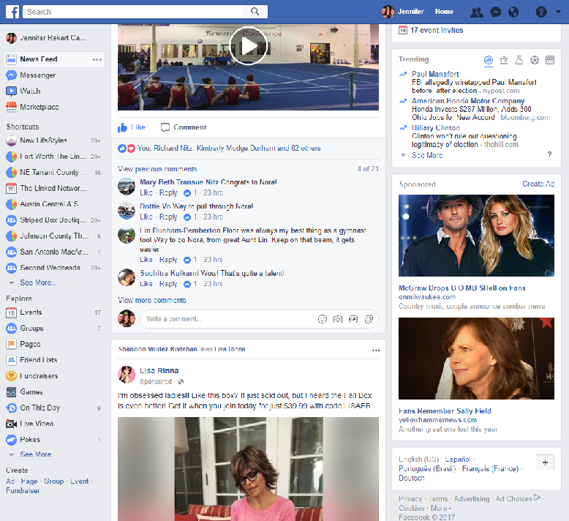
Social Media Advertising
On Facebook, Twitter, Snapchat, Instagram, Pinterest, etc…

Slide 11
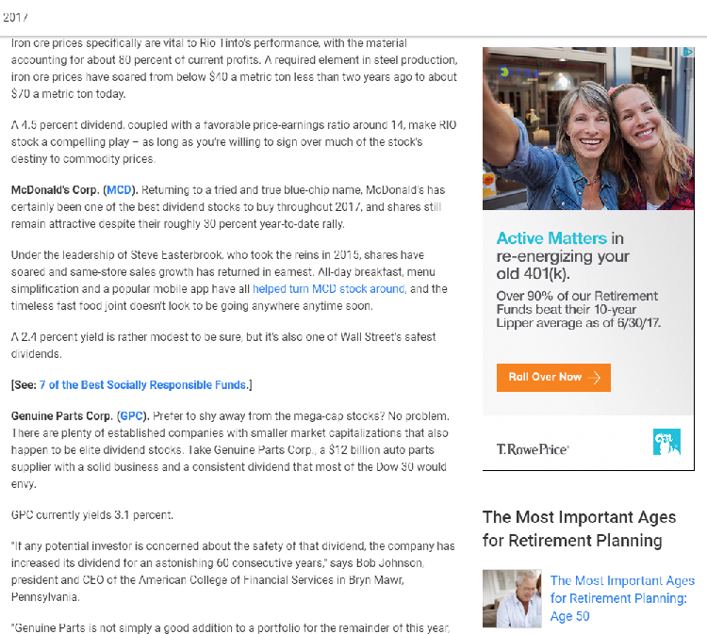
Display Advertising
Banner Ads, etc. – Visual on specific website or community of sites

Slide 12
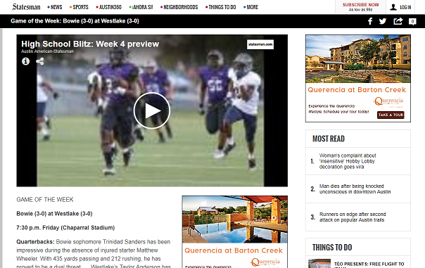
Remarketing/Retargeting
Show ad to people who have already visited your site
On Facebook, Google & Others

Slide 13
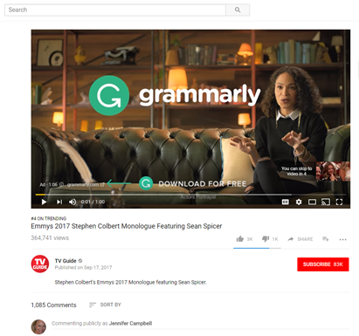
Video Advertising
Post on YouTube, Facebook, Vimeo, Twitter, etc..

Slide 14
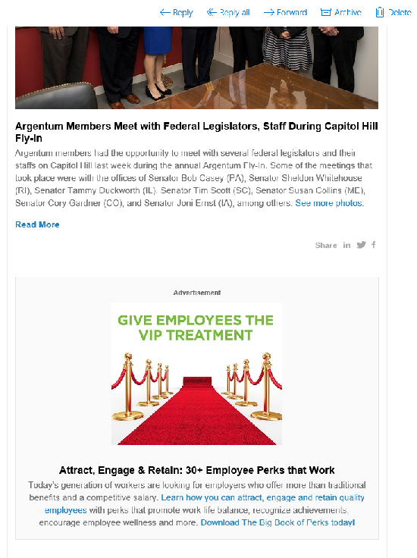
Email Marketing
Your Own - Newsletter, Quizzes, Promotions, etc.. (Remember Spam Rules)
Advertise in another

Slide 15
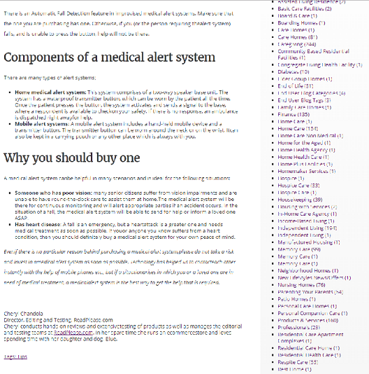
Blog/Content Sponsorship (Native Advertising)
Write blog for another site for link & authority &/or sponsor content with your ad at the bottom

Slide 16
Types of Online Advertising/Marketing
Jennifer Campbell
Jennifer@NewLifeStyles.com
800-975-9439

